Slide 1


OPS Lecture 3:
Transistors

Slide 2
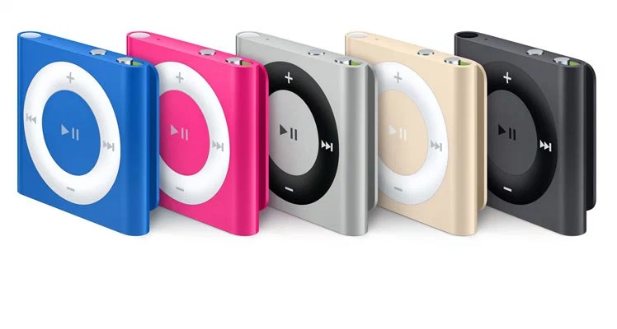
iPoduino Project Recap:
Using digital/analog (turning on a LED vs. reading from a potentiometer)
How duty cycle and frequency affect a PWM wave
Change the frequency of a 50% PWM wave using tone() to play different notes

Slide 3
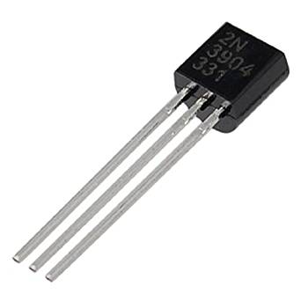
What’s a transistor?
Two main functions:
Electronic Switch: a small current turns on/off a big current
Signal Amplifier: Turns a small current into a big current
Has 3 terminals
Notes:
The small current at the base of a transistor controls the current flowing from the C to E and vice versa

Slide 4
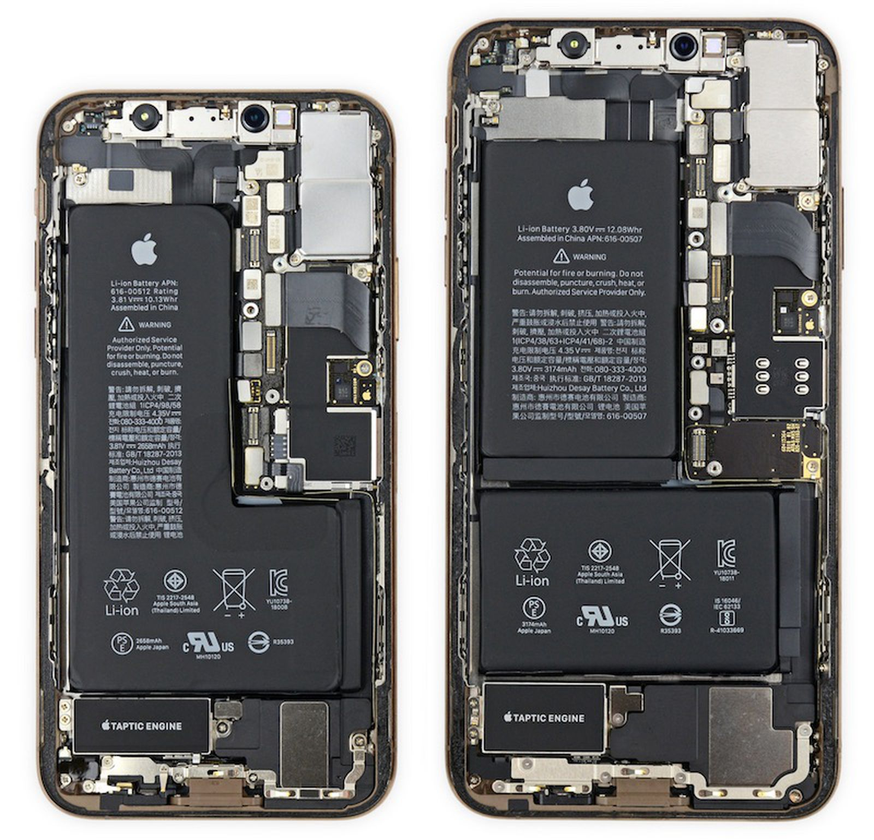
How many transistors are in the Iphone XS chip?
The 7nm chip has 6.9 billion transistors!
Transistors are essential to electronics
More transistors = More logic = More computing power!

Slide 5
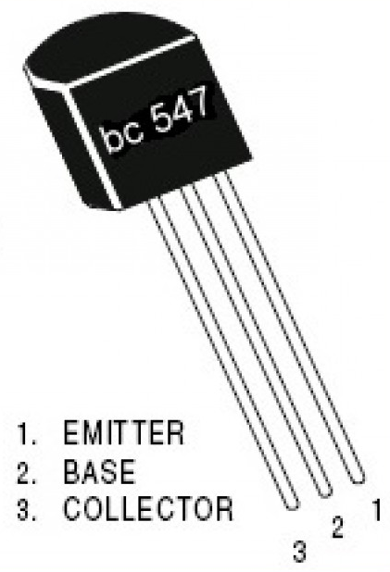
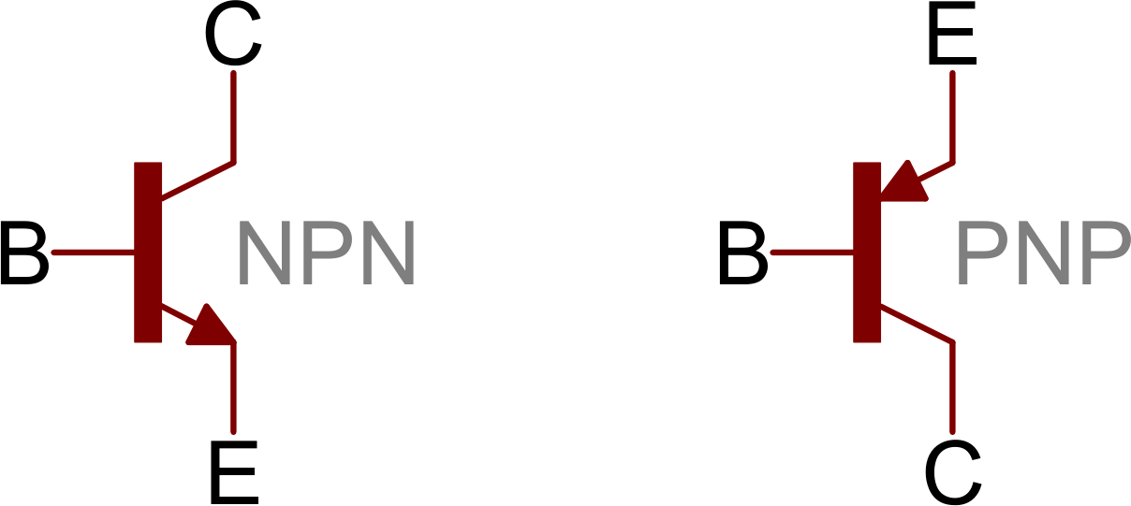
Transistors: A Closer Look
PHYSICAL TRANSISTOR
3 main components:
Emitter
Collector
Base
Current travels from C to E or vice versa
Base controls if this current is on/off(switch) or amplified(amplifier)
Emitter always has arrow in the transistor symbol
SCHEMATIC SYMBOL

Slide 6
2 Types of BJT Transistors
NPN and PNP

Slide 7
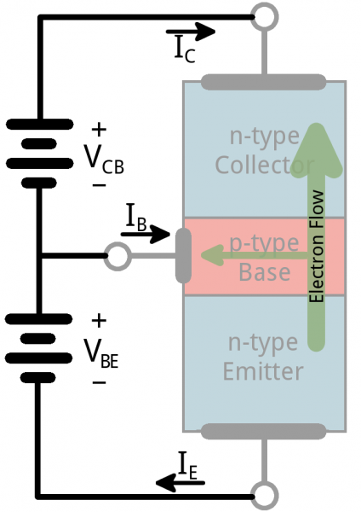
NPN Transistor
current
Backwards logic: Arrow from emitter is Not Pointing iN
Arrow denotes where the current flows -- from COLLECTOR to EMITTER
If enough voltage is applied at the base, current will start to flow from C to E!
Emitter emits electrons to collector since Electron and Current flow are opposite

Slide 8
PNP Transistor
Arrow denotes where the current flows -- from EMITTER to COLLECTOR
This means that electrons flow from collector to emitter
Emitter emits holes, which are conceptually the absence of electrons
current

Slide 9
In general
The transistor is kind of like an electron valve
The base pin is like a handle you might adjust to allow more or less electrons to flow from emitter to collector

Slide 10

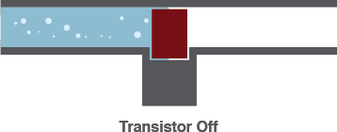
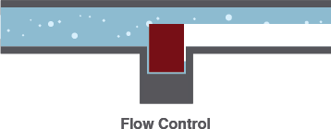
Water analogy revisited
Transistor as a water valve. Current = flow of water
3 States
On: Short Circuit
allows water to flow completely unblocked. Switch is closed
Off: Open Circuit
valve completely stops flow of water . Switch is open
Linear Flow Control
valve can control amount of flow
Notes:
Very high level overview

Slide 11
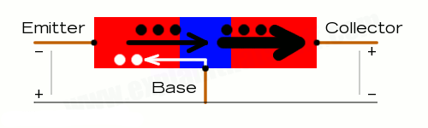
Example: NPN Transistor as a Switch
Say the Emitter is (-) and the Collector is (+)
When we connect the Base to power, electrons will travel through the base from the emitter to the collector
When we disconnect the base from power, no electrons travel
The transistor acts as a switch, controlled by power to the base!
Notes:
SKIP

Slide 12
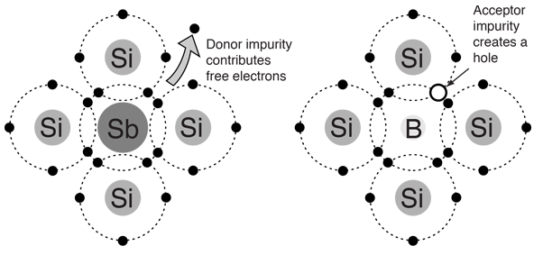
Transistors: A More Conceptual Look
Transistors behave the way they do because they are made out of semiconductors
By doping these semiconductors with impurities, we can cause them to have either fewer “free” electrons (p-type silicon, positive) or more “free” electrons (n-type silicon, negative)
When we put p-type and n-type silicon next to each other in a circuit, electrons will only travel from n to p, but not the opposite (diode)
By adding another doped silicon, we end up with a NPN or PNP transistor
This is covered more in ESE 273 and other transistor courses, so not super important right now, so don’t worry!
Notes:
SKIP

Slide 13
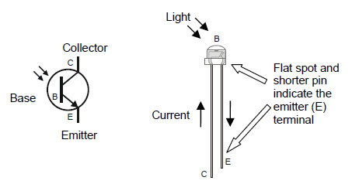
Phototransistors
Phototransistors are a type of transistor that respond to light
Base inside the bulb absorbs light, and acts like a switch
If it senses light, current will be allowed to pass through from collector to emitter
If no light sensed, less current flows
Notes:
What kind of transistor is this??? npn since the arrow from the emitter is not pointing in and current flows from collector to emitter. Electrons flow from emitter to collector.

Slide 14
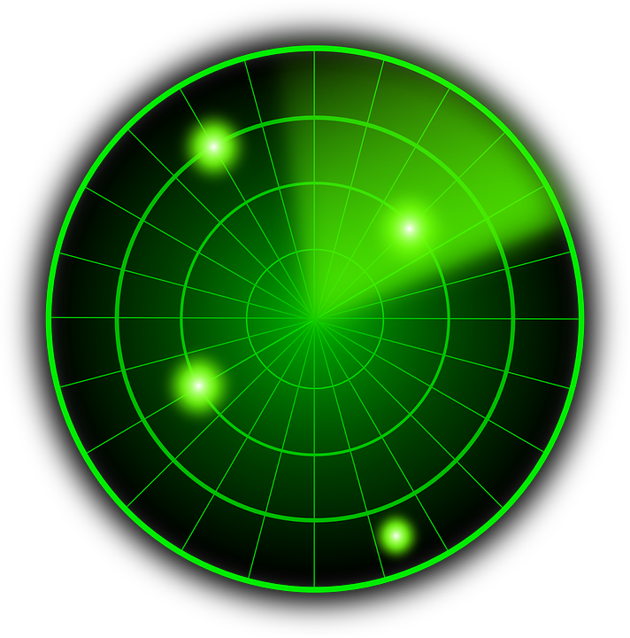
Project 3:
Distance Sensor

Slide 15
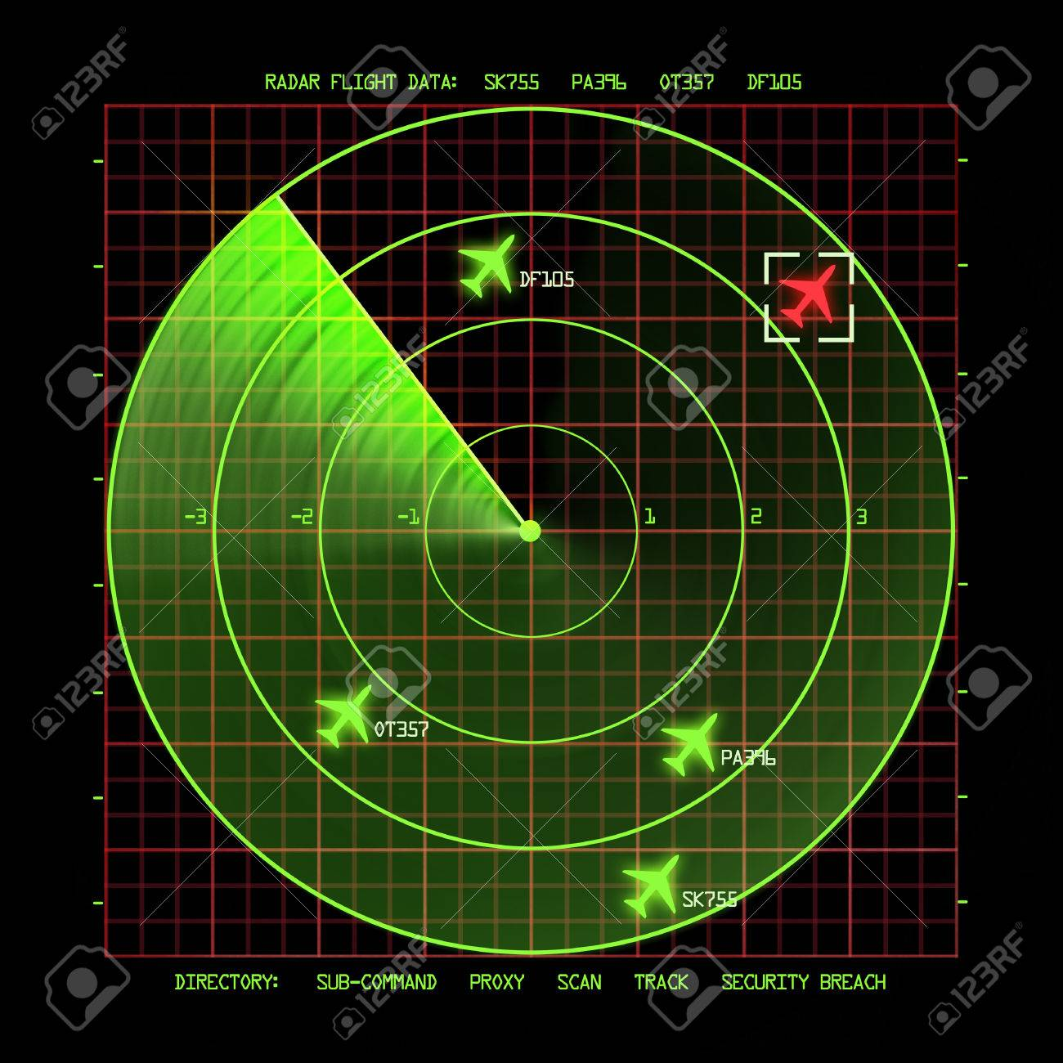
Project 3: Distance Sensor
Using your Arduino, LEDs, IR Emitters, and IR phototransistors, make a Distance Sensor!
The closer an object is to the sensor, the brighter the LED should be
We can control LED brightness with
PWM

Slide 16
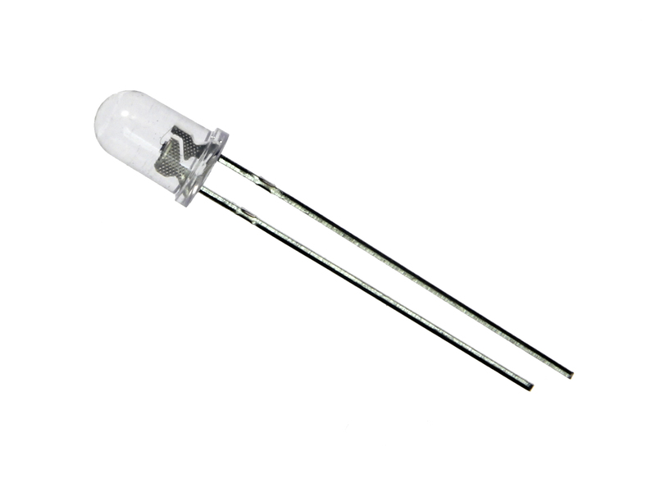
IR Receiver/ IR Phototransistors
We will be using IR phototransistors, which respond to Infrared light
Collector (+): Shorter lead, flat edge
Emitter (-): Longer lead, round edge
Note how a phototransistor looks just like a white LED, but with reversed polarity…
B
E(-)
C(+)

Slide 17
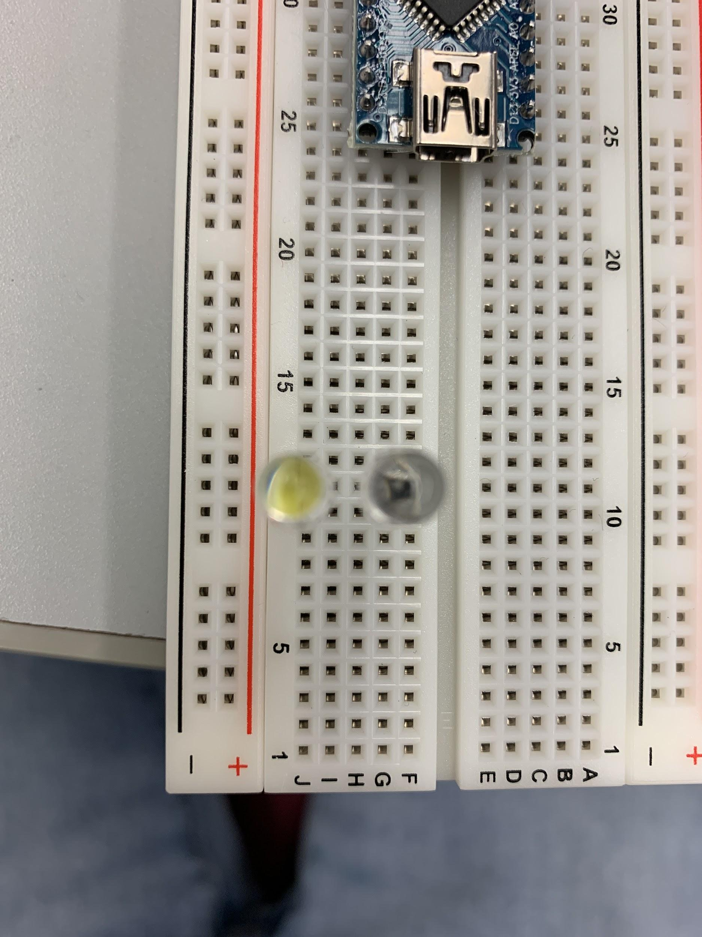
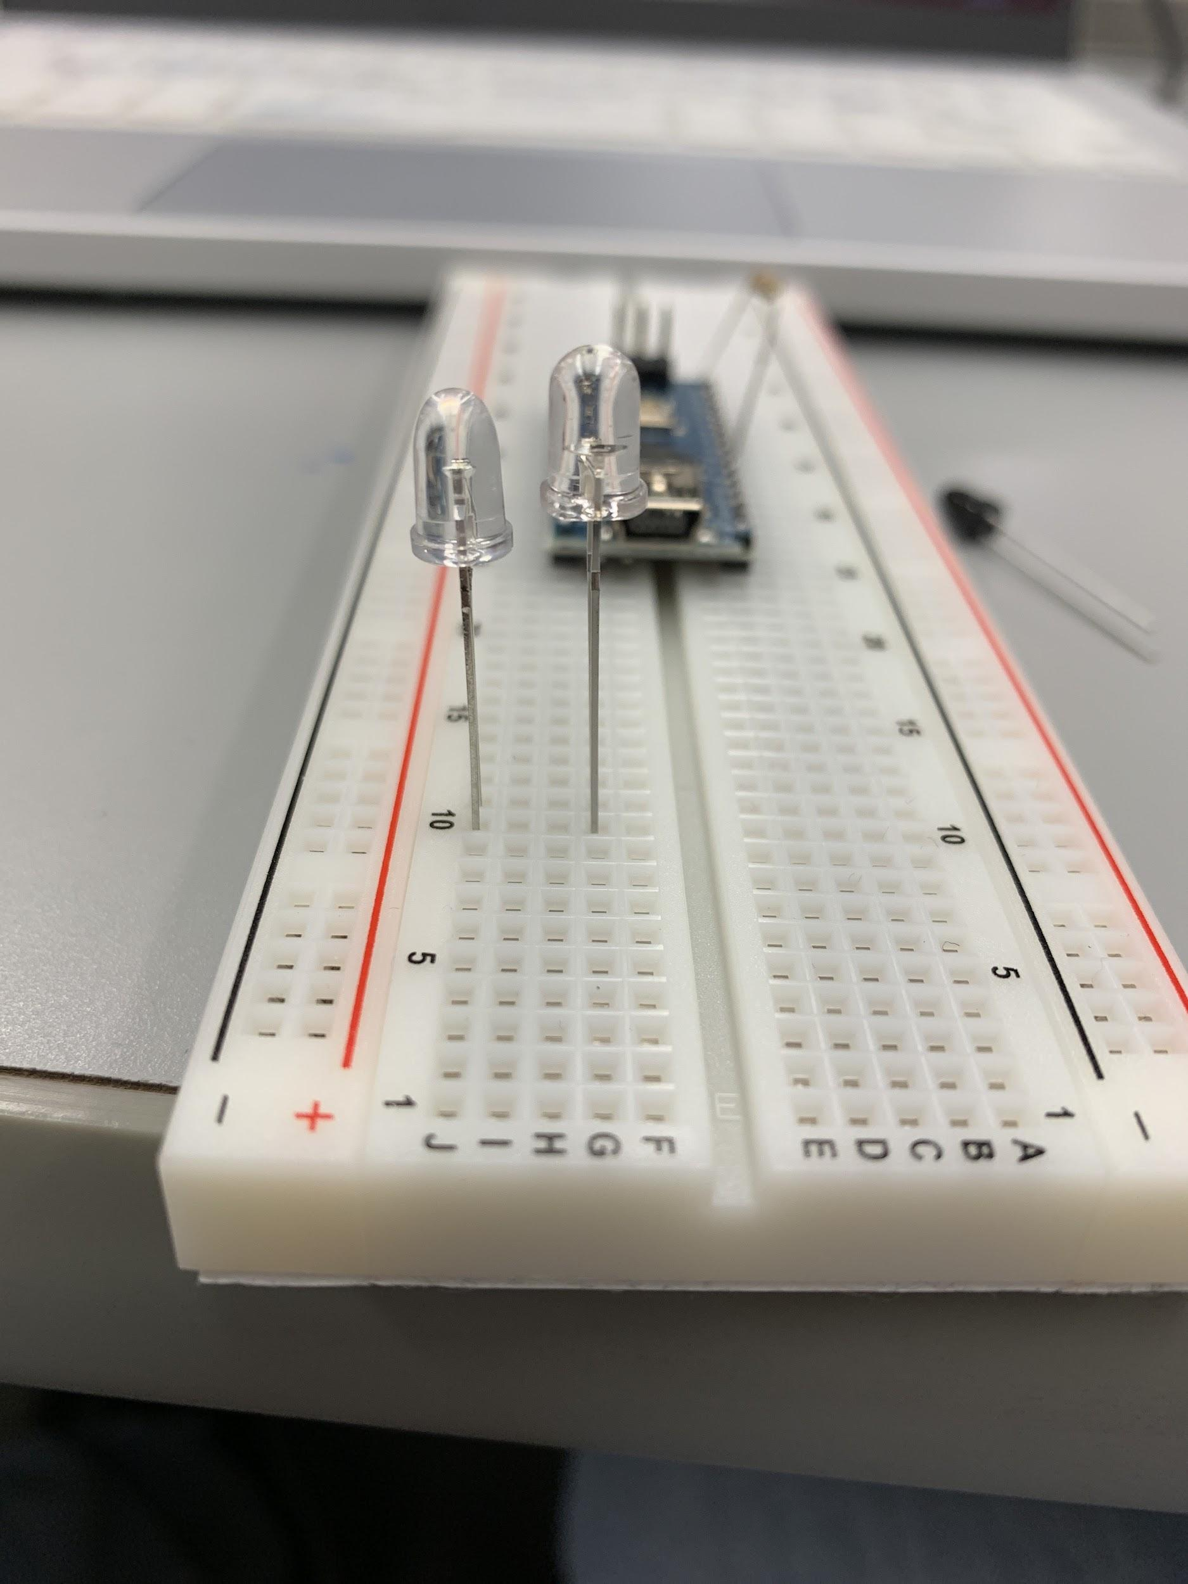
White LED & IR receiver: which one is which?
They look the same D:
Just look at it from the top:
Left: led, right: IR receiver
BE CAREFUL NOT TO MIX THEM UP!

Slide 18
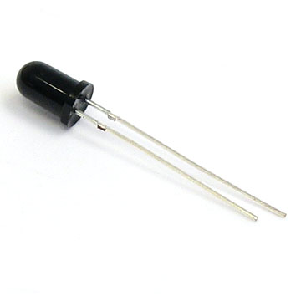
IR Emitter/IR LED
Emits Infrared light
Anode (+): Shorter lead, round edge
Cathode (-): Longer lead, flat edge
Notice again that figuring out polarity is different from regular LEDs

Slide 19
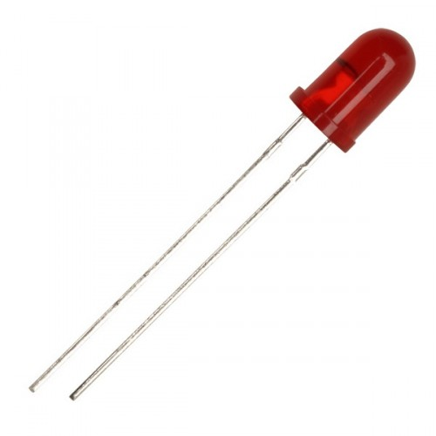
Polarity Chart
Type | Positive (+) | Negative (-)
LED | Longer lead Round Edge | Shorter Lead Flat Edge
IR Receiver/Phototransistor | Shorter Lead Flat Edge | Longer Lead Round Edge
IR Emitter/LED | Shorter Lead Round Edge | Longer Lead Flat Edge

Slide 20
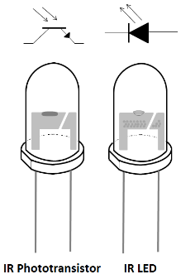
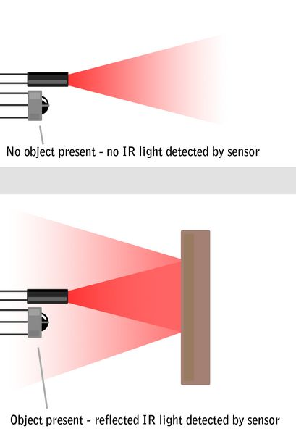
How it works: IR Emitter/Receiver Pairs
We will place an IR emitter and an IR receiver right next to each other
If an object is placed in front, it will reflect IR light into the receiver

Slide 21
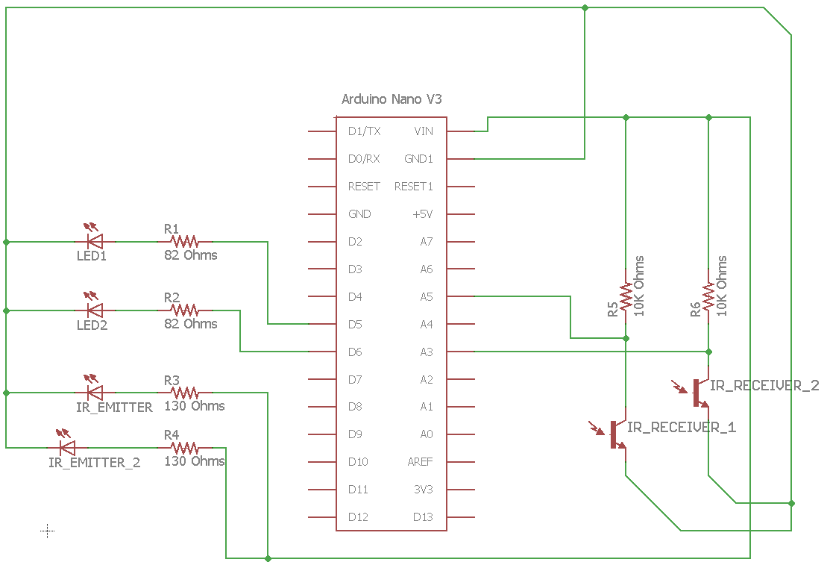
Project Schematic..?
Faulty Schematic
Because of the way the analog pins are set up, analogRead( ) will read 0 when there is lots of light and 1023 when there is no light
How can we fix this?
Switch the resistor and the transistor!
You could also tweak the program...
Notes:
More light = more current A5 will read 0
Less light = no current from C to E, so switch will be open and A5 will read VIN (remember, input impedance is really high compared to the resistor)

Slide 22
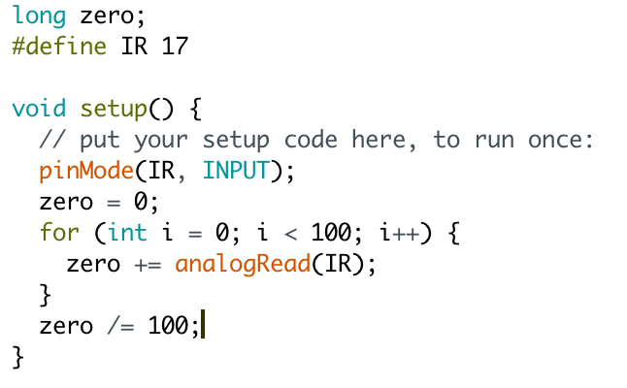
Noise Calibration
There’s always going to be a little bit of IR light in the background— aka “noise”
We can sample the background noise in our setup() and use it as our new “zero”
In the example, we take 100 samples and take the average

Slide 23
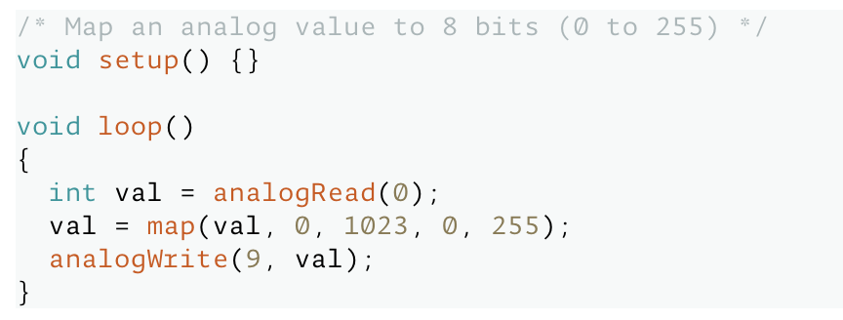
Arduino function: map( )
map(value, initial_min, initial_max, final_min, final_max)
Official documentation here
Scales a value from an initial range to a final range
Does not modify original value, so we must assign the returned value to a variable
Make sure the value is inside the initial range, otherwise map( ) may behave strangely
Example: We read a value from 0-1023, but want to scale it to 0-255 so we can analogWrite( ) to an LED

Slide 24

Pop Quiz!
What is the output of the following?
int val = 4;
val = map(val, 0, 10, 100, 150);
Serial.println(val);
Output: _____
120

Slide 25
Arduino function:
constrain( )
Sometimes, for a variety of reasons, we may end up with values that are out of bounds. To ensure this doesn’t happen, it’s always a good idea to use constrain( ).
constrain(x, a, b)
Official documentation here
returns x if a < x < b
returns a if x <= a
returns b if x >= b

Slide 26


Project Deadlines
Distance sensor will be due:
Monday Students: 10/25
Thursday Students: 10/28
More project details here
Come to our LAB HOURS for help!
Check out lab hours for:
(Mon): Ryuichi, Rachel, or
(Thur): Wesley, Paula

Slide 27

Thank You!

